Slide 1


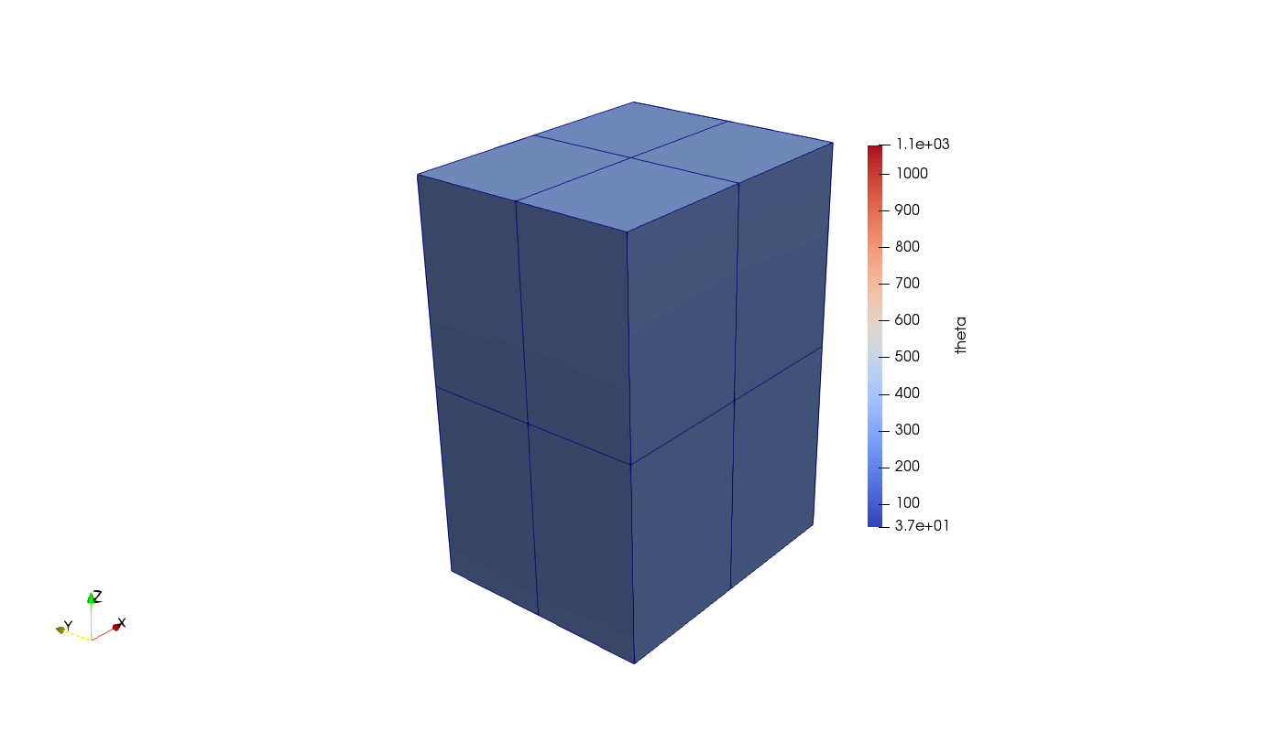


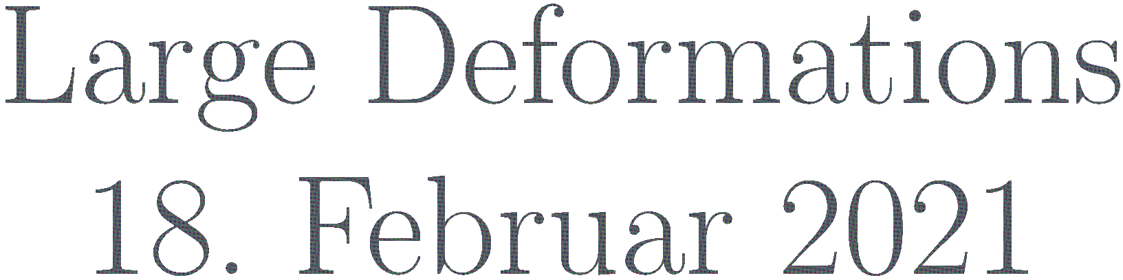


Slide 2


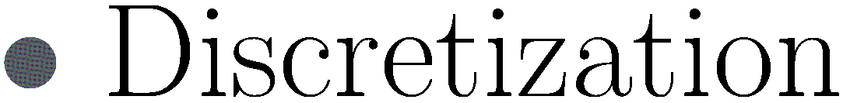


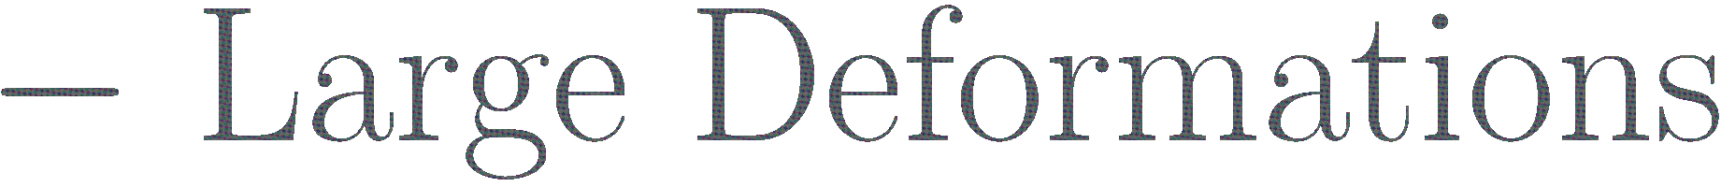
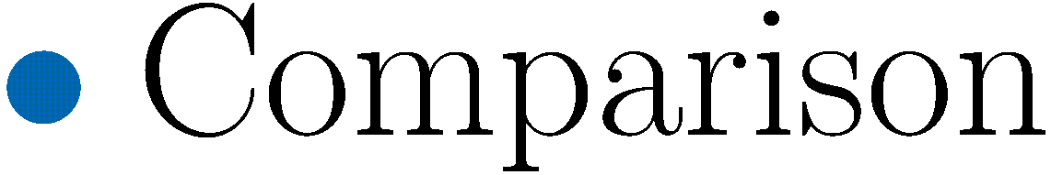


Slide 3

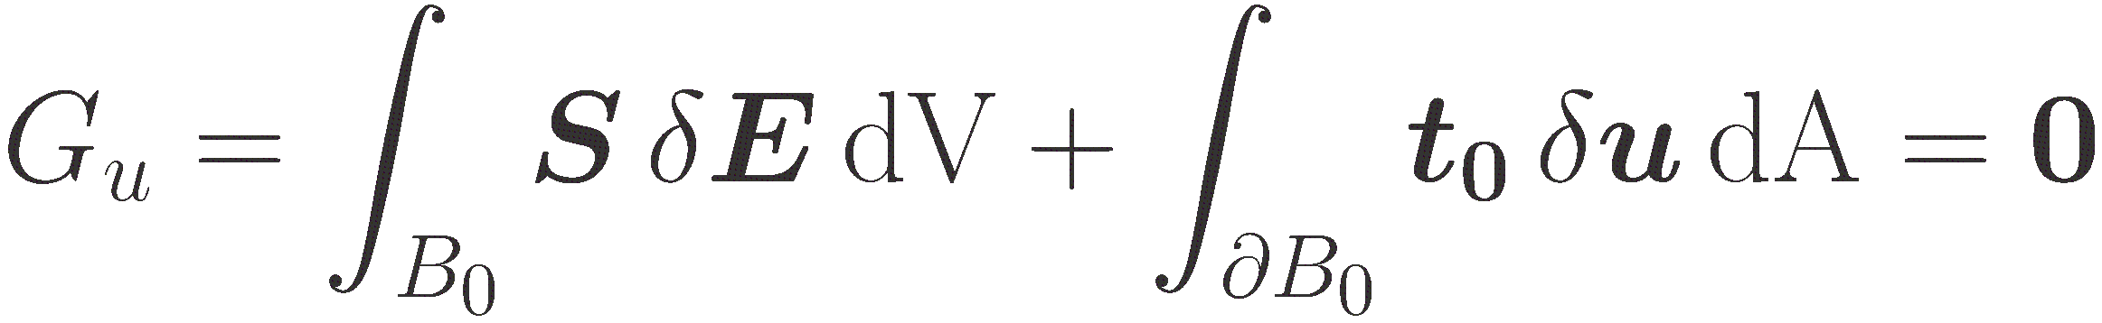
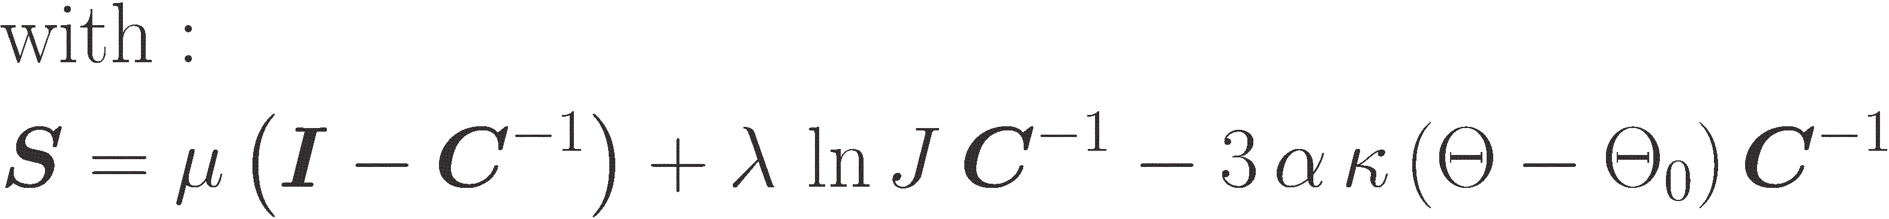
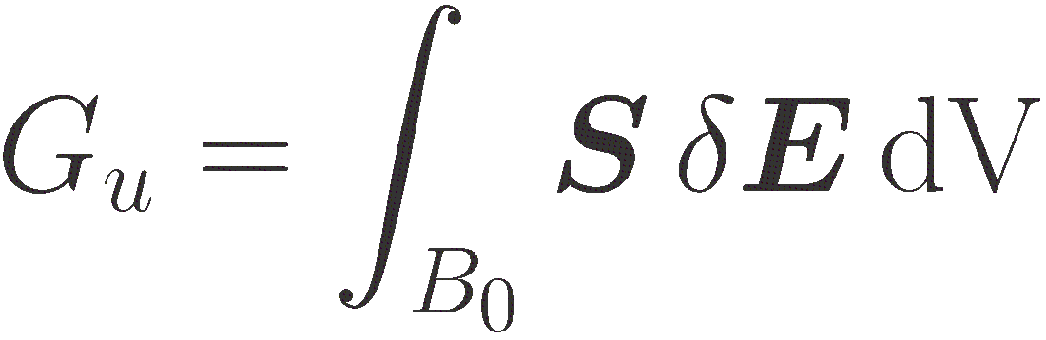


Slide 4
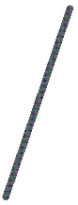

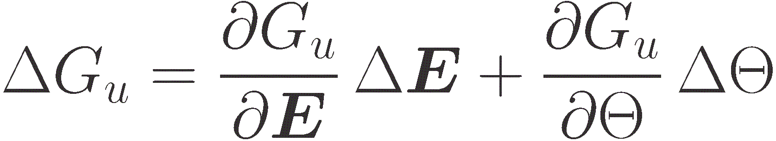
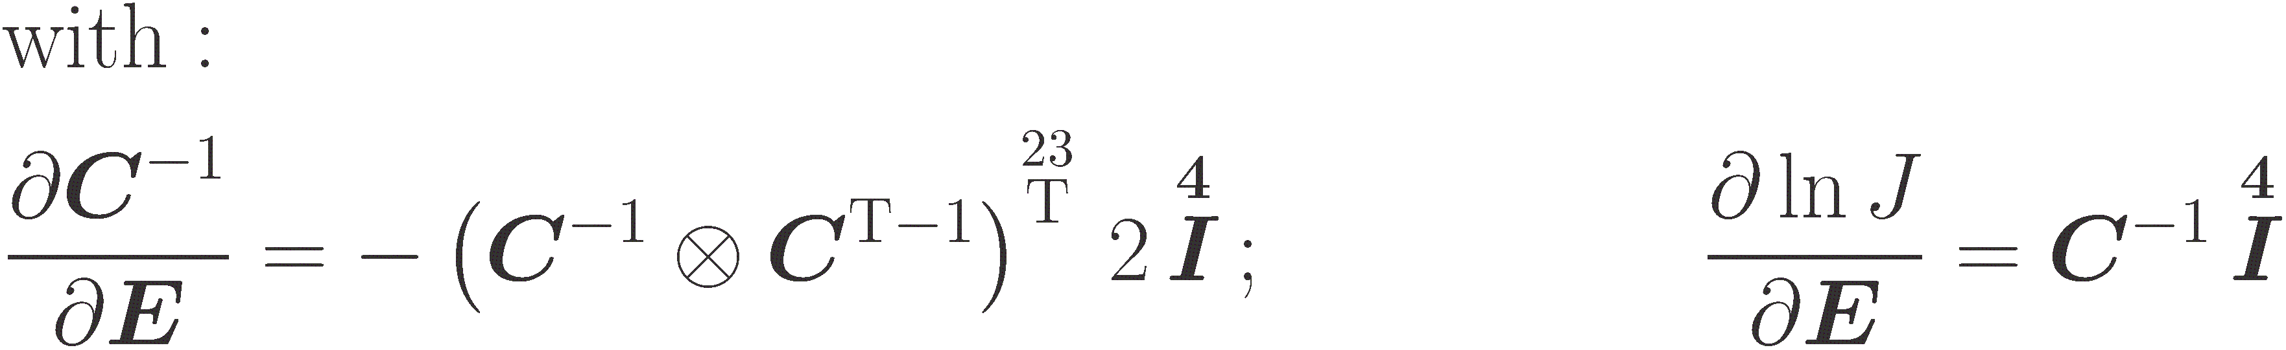
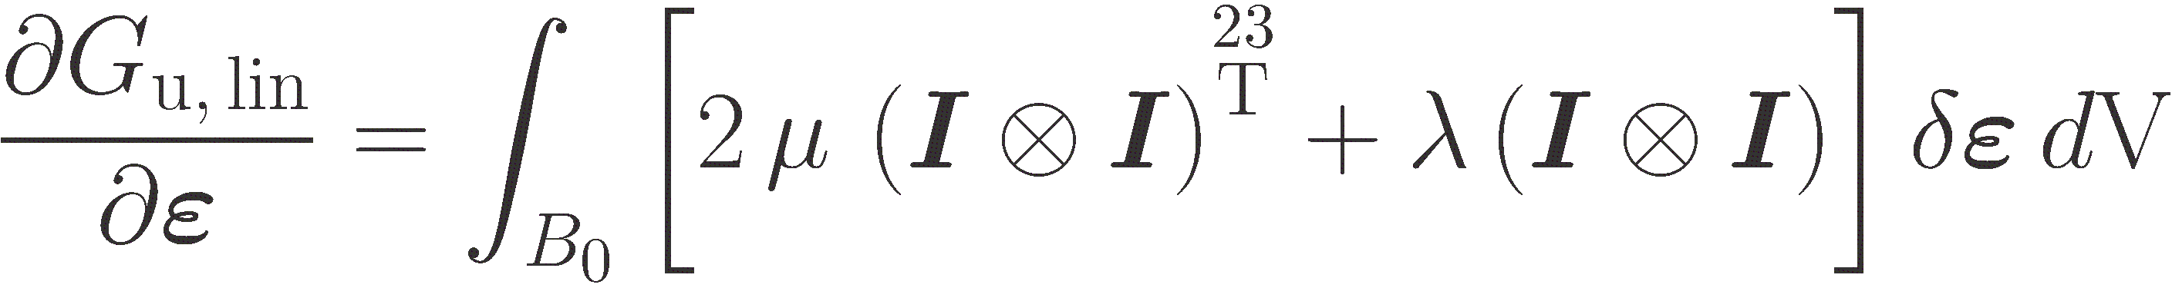
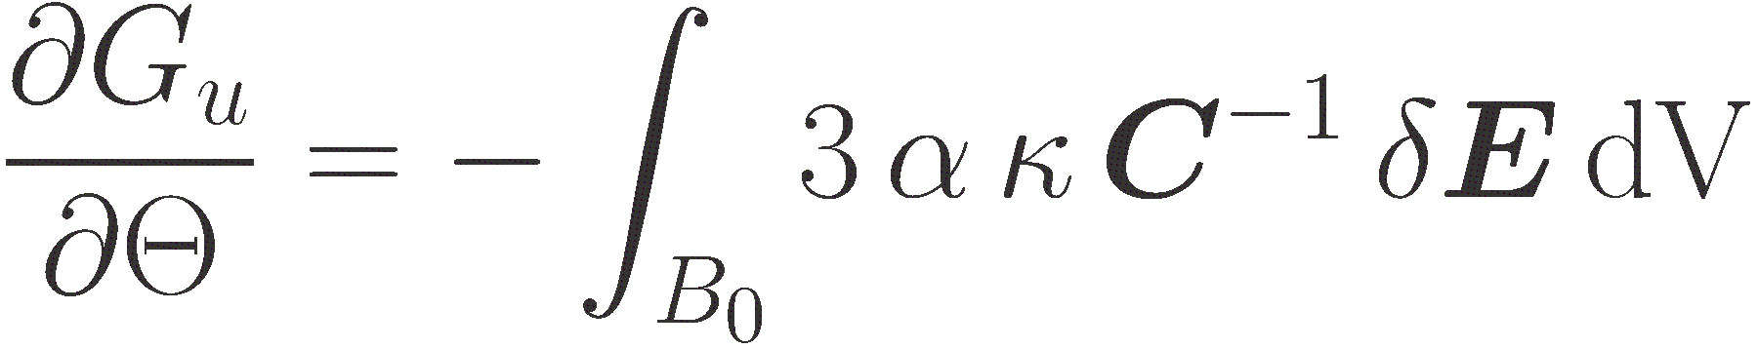

Slide 5
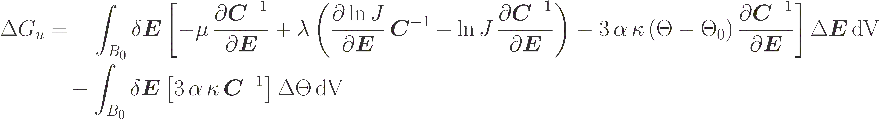

Slide 6

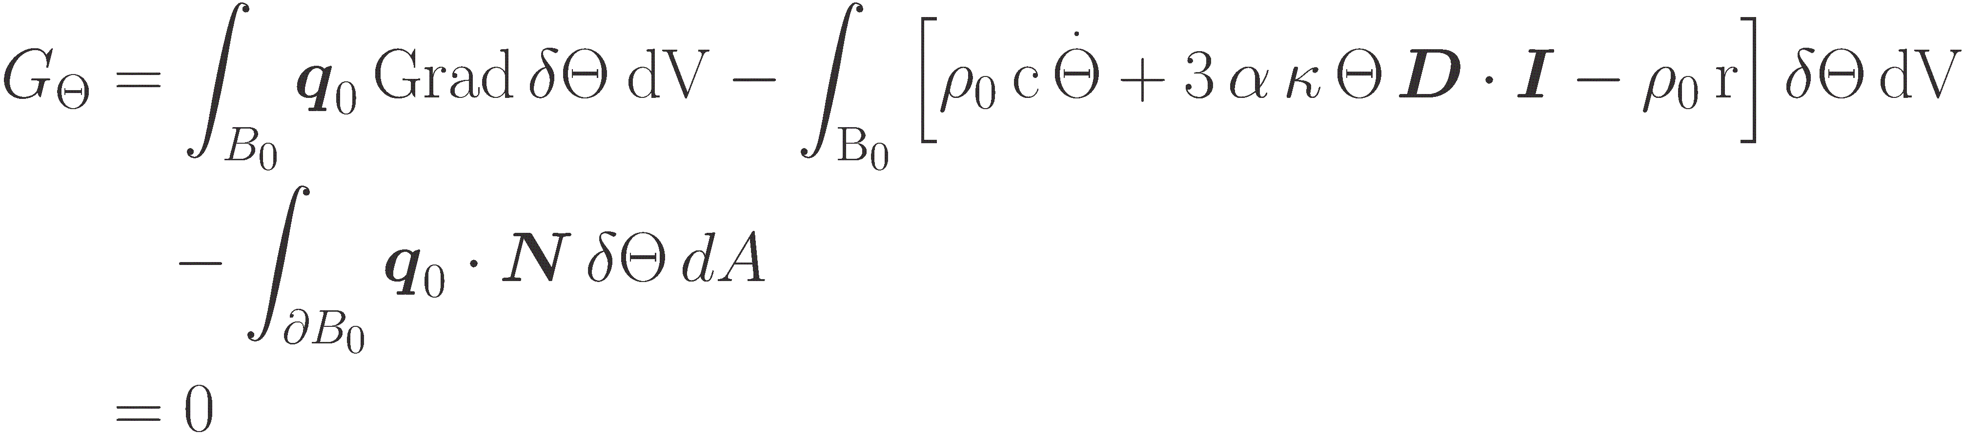
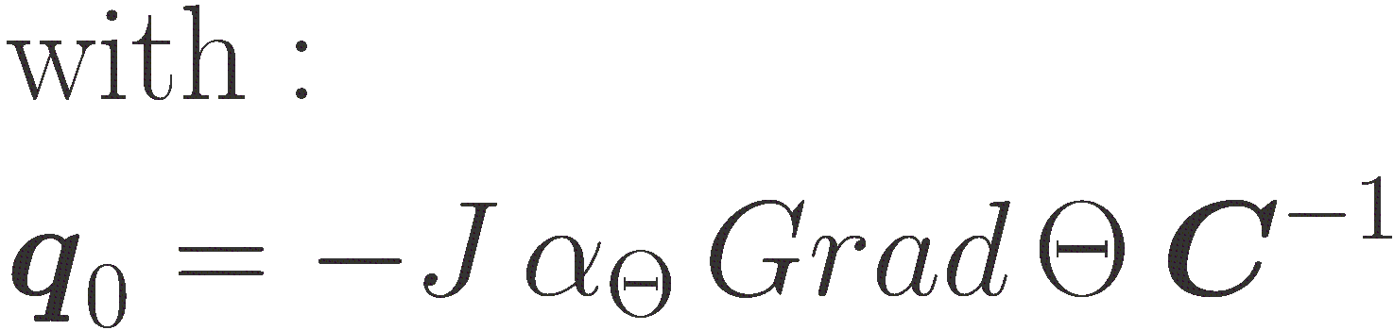

Slide 7
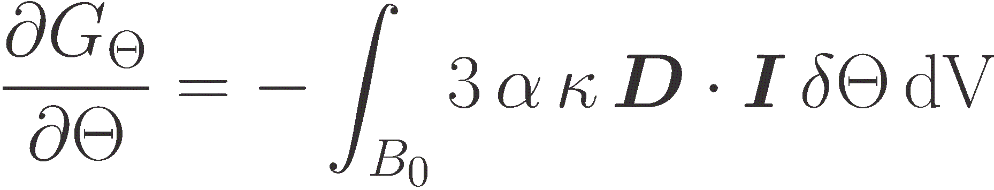
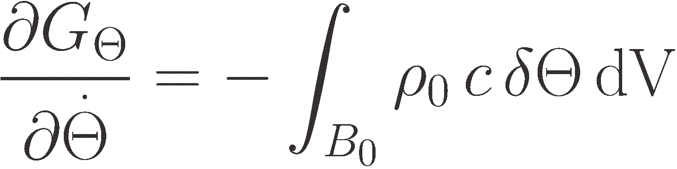
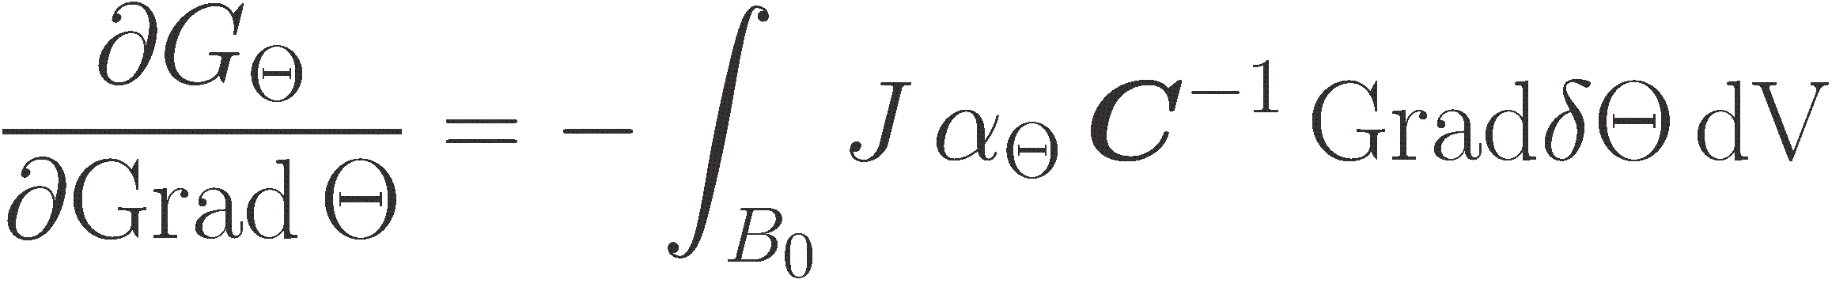
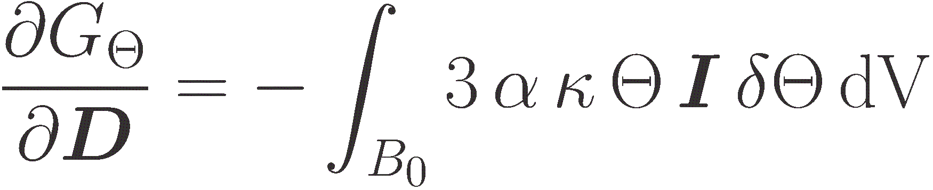

Slide 8
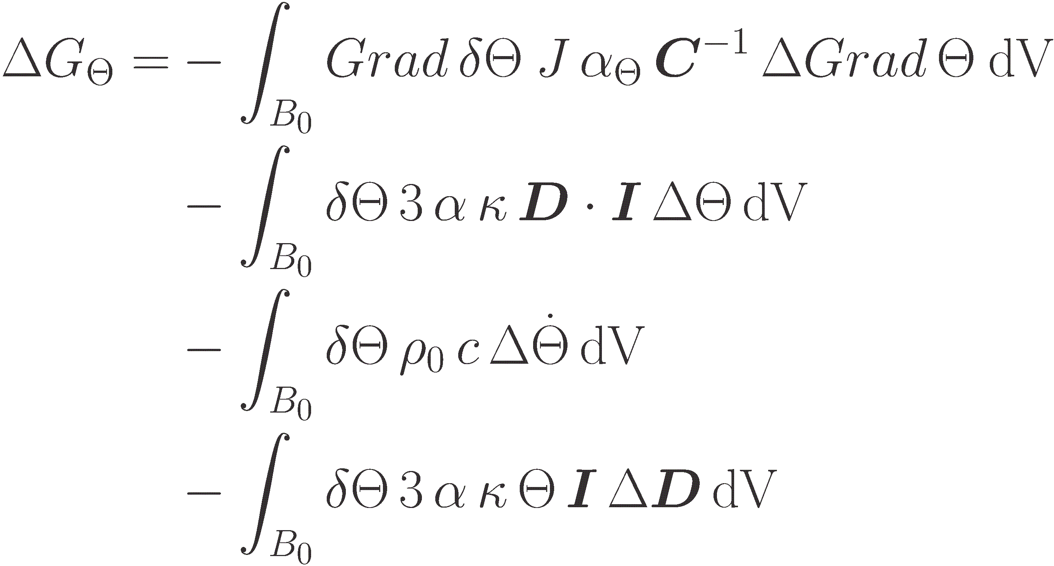

Slide 9

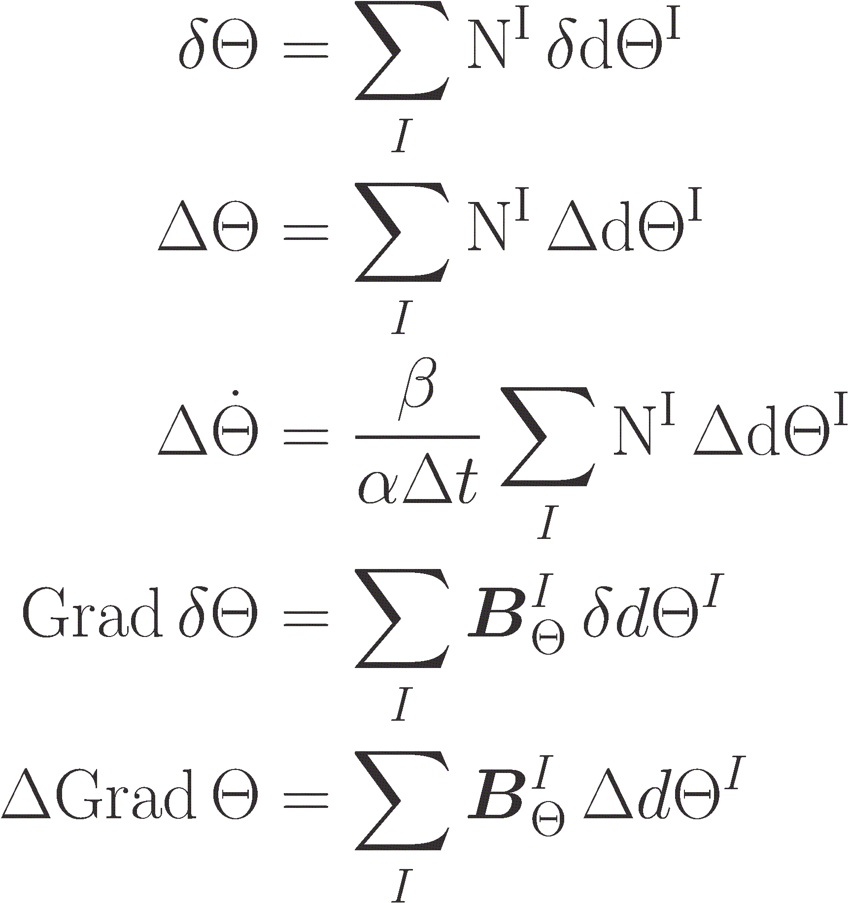
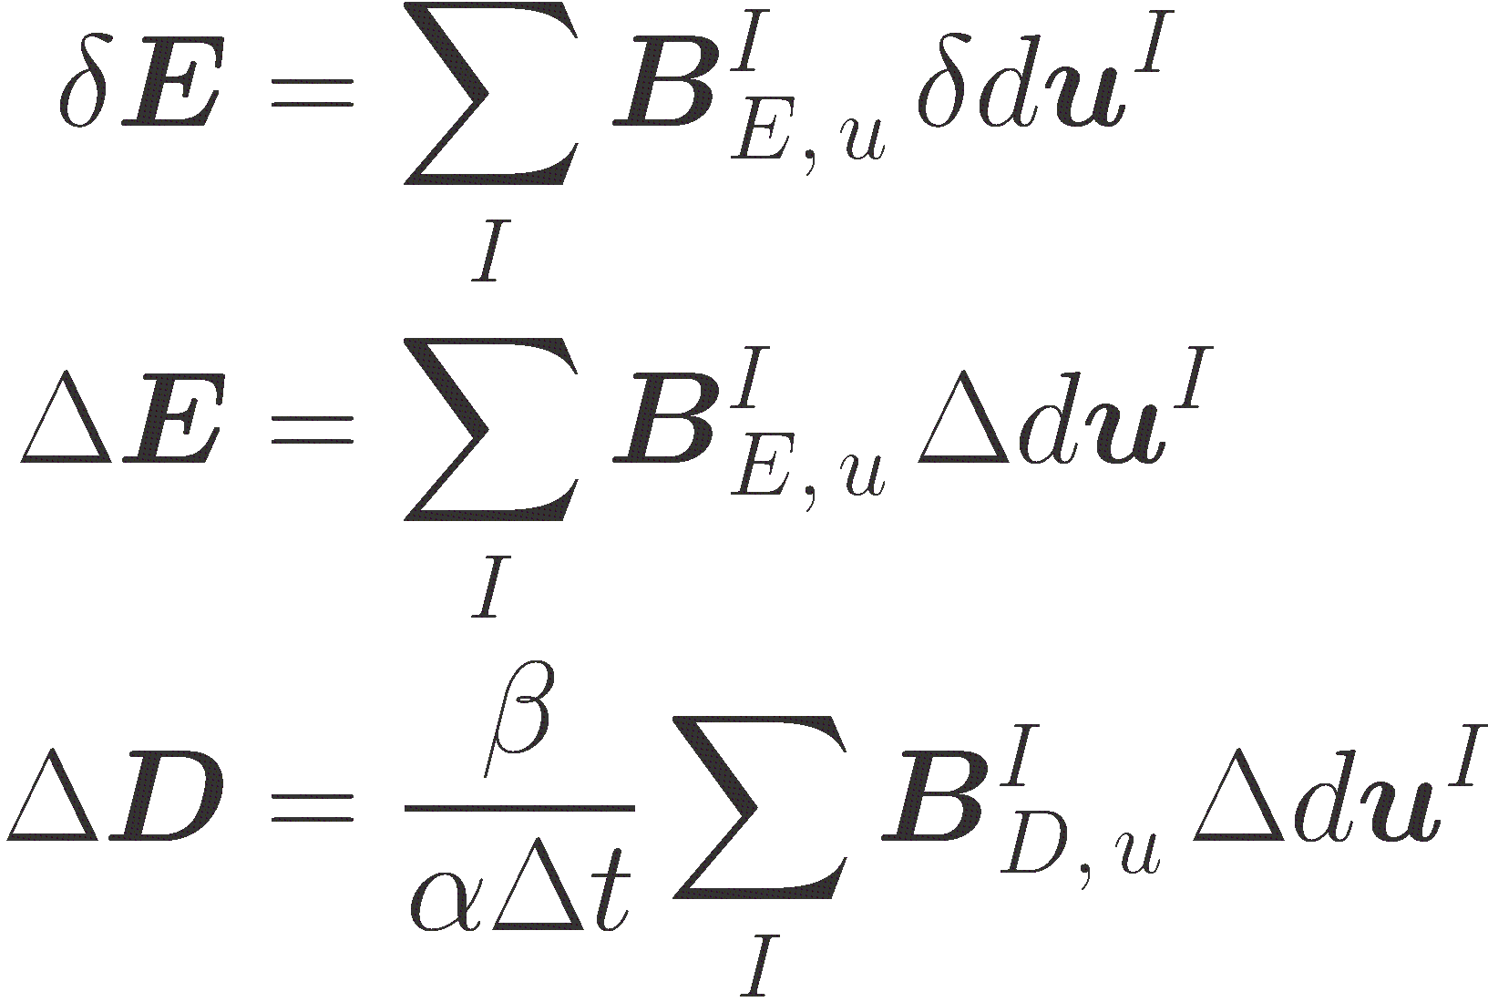

Slide 10
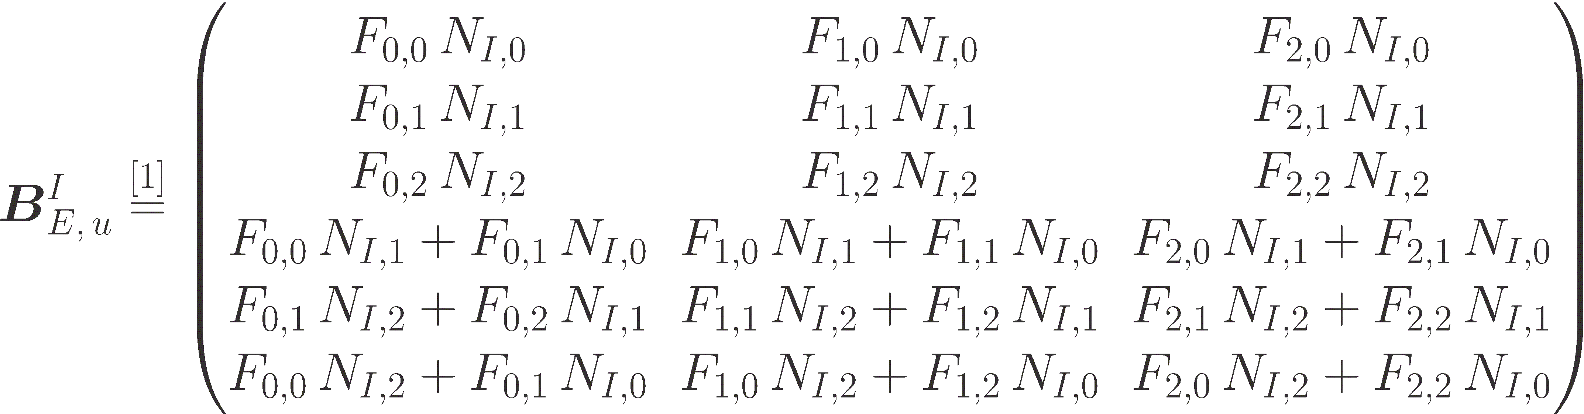
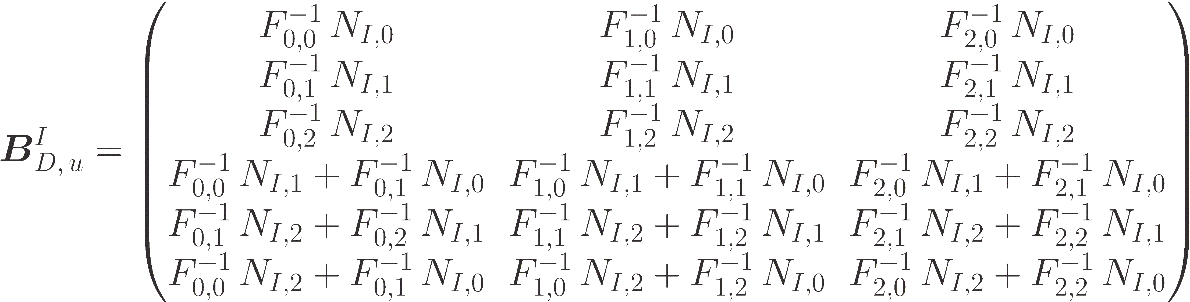

Slide 11

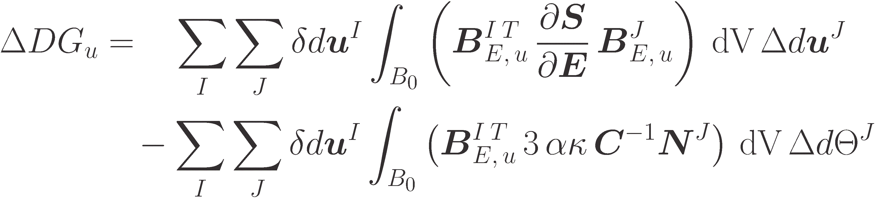
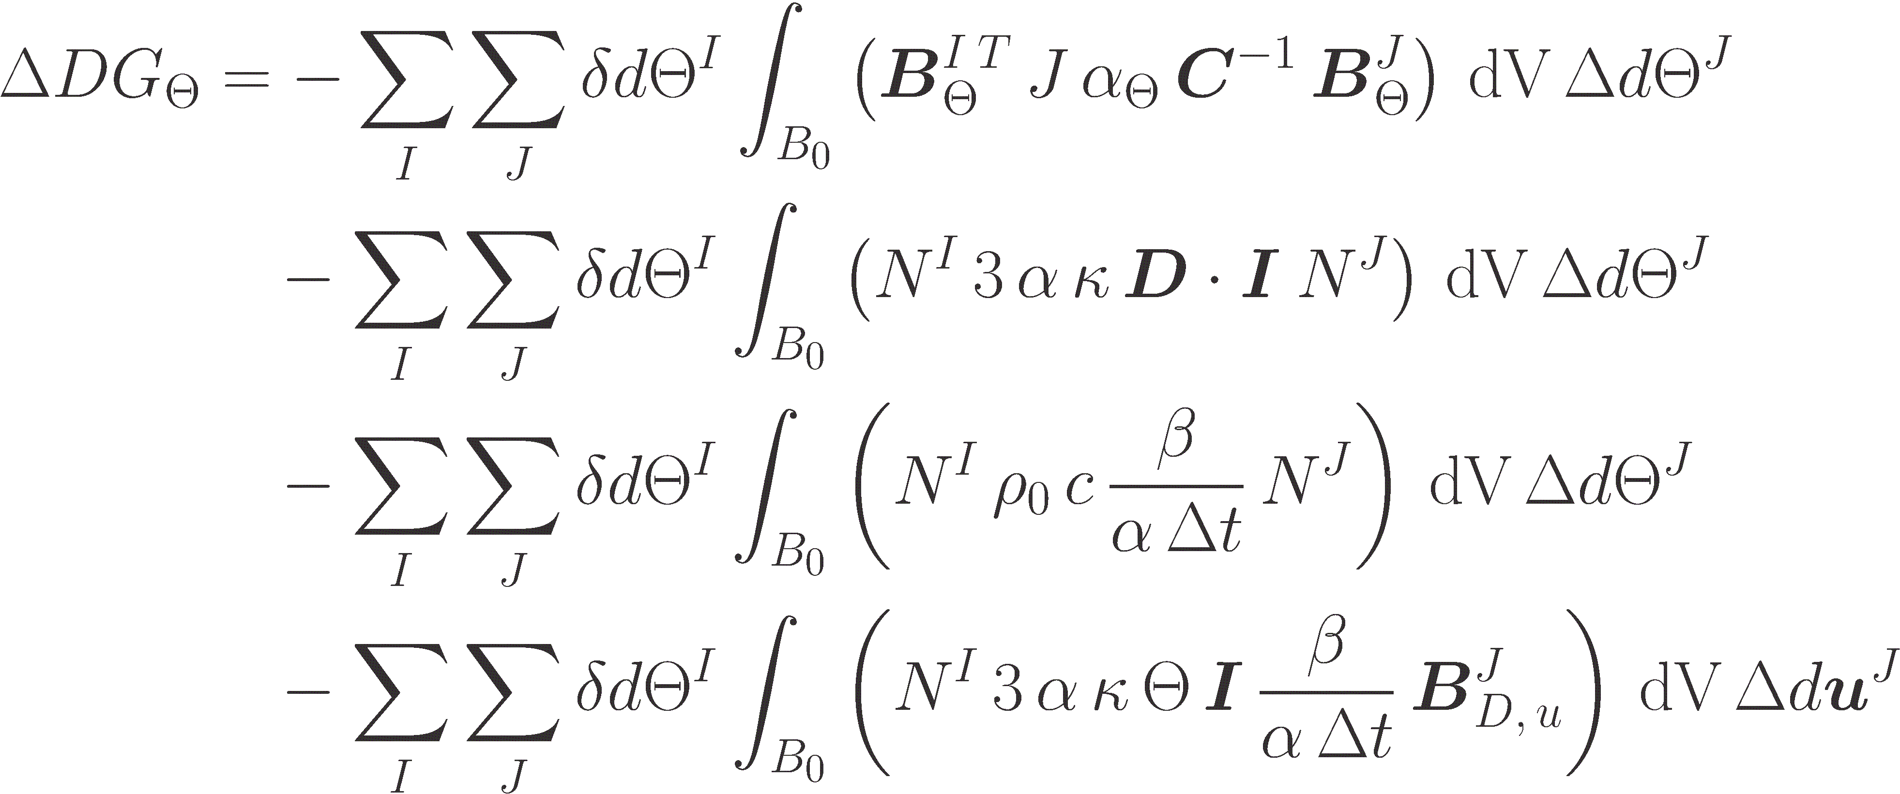
Notes:
Momentum: VarE deltaE; varE deltaTheta
Balance: Grad-varTheta deltaGradTheta; varTheta deltaTheta; varTheta deltaThetadot; varTheta deltaD
Position in Stiffness matrix: u-u, theta-theta & mixed terms

Slide 12
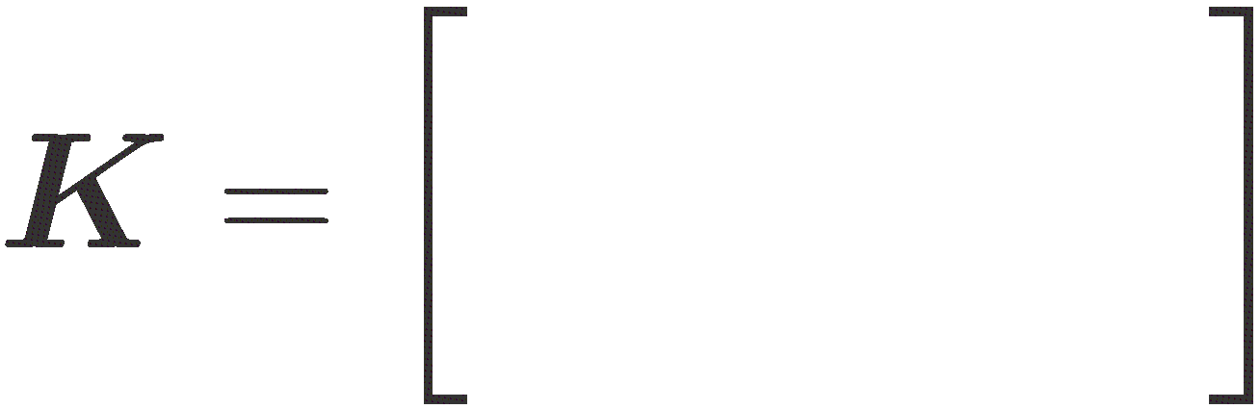
Notes:
Momentum: VarE deltaE; varE deltaTheta
Balance: Grad-varTheta deltaGradTheta; varTheta deltaTheta; varTheta deltaThetadot; varTheta deltaD
Position in Stiffness matrix: u-u, theta-theta & mixed terms

Slide 13
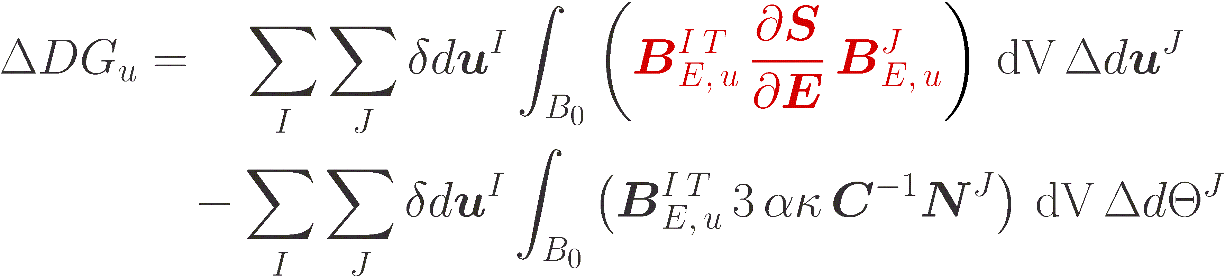
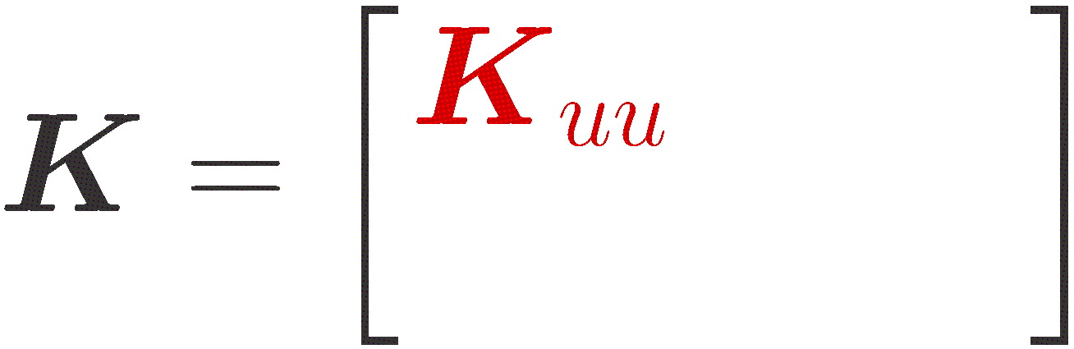
Notes:
Momentum: VarE deltaE; varE deltaTheta
Balance: Grad-varTheta deltaGradTheta; varTheta deltaTheta; varTheta deltaThetadot; varTheta deltaD
Position in Stiffness matrix: u-u, theta-theta & mixed terms

Slide 14
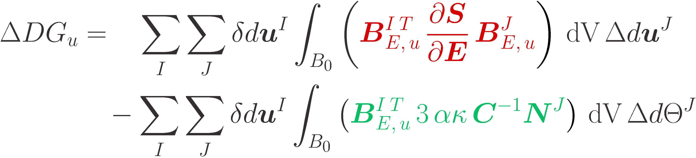
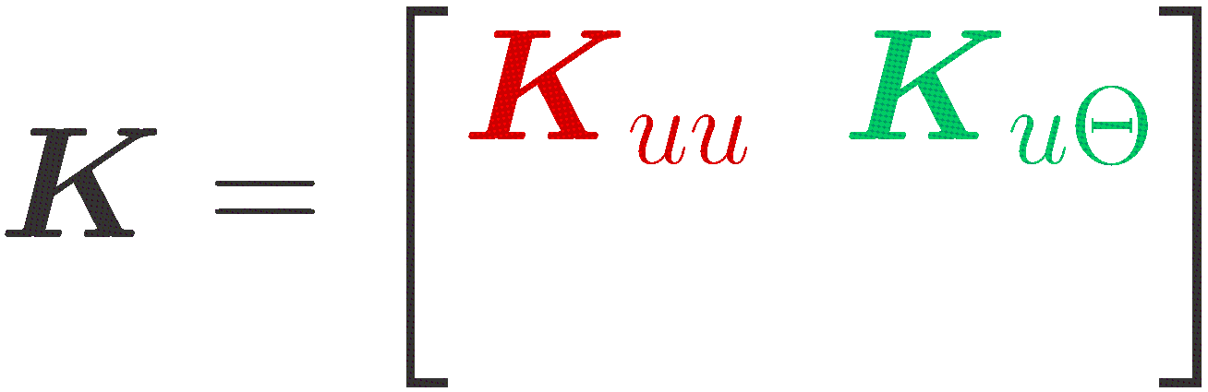
Notes:
Momentum: VarE deltaE; varE deltaTheta
Balance: Grad-varTheta deltaGradTheta; varTheta deltaTheta; varTheta deltaThetadot; varTheta deltaD
Position in Stiffness matrix: u-u, theta-theta & mixed terms

Slide 15
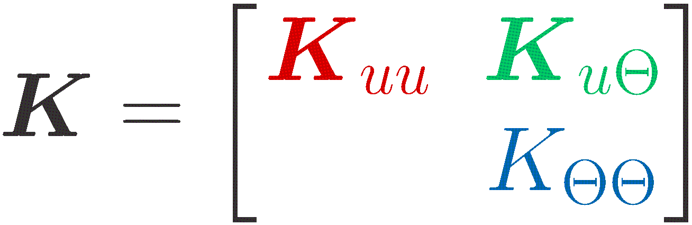
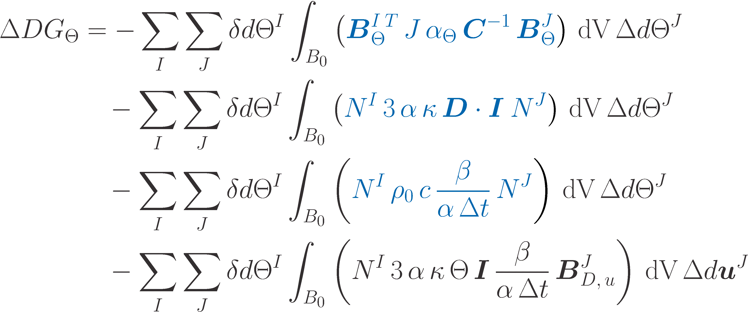
Notes:
Momentum: VarE deltaE; varE deltaTheta
Balance: Grad-varTheta deltaGradTheta; varTheta deltaTheta; varTheta deltaThetadot; varTheta deltaD
Position in Stiffness matrix: u-u, theta-theta & mixed terms

Slide 16
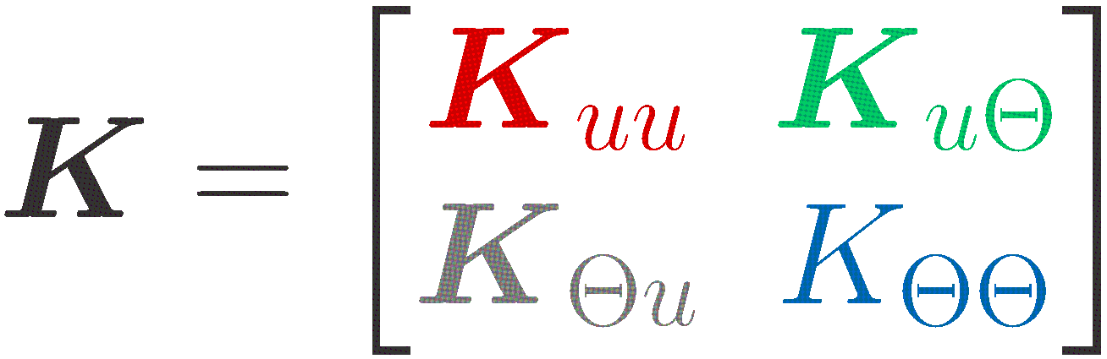
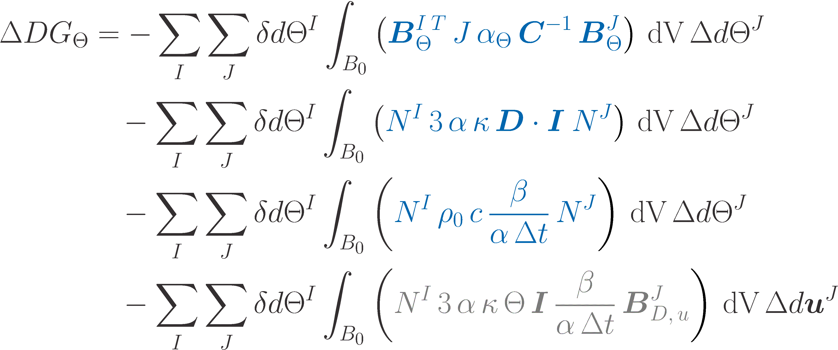
Notes:
Momentum: VarE deltaE; varE deltaTheta
Balance: Grad-varTheta deltaGradTheta; varTheta deltaTheta; varTheta deltaThetadot; varTheta deltaD
Position in Stiffness matrix: u-u, theta-theta & mixed terms

Slide 17

Notes:
D… Symmetric strain –velocity-tensor/rate of deformation-tensor
c… right-Cauchy-green-strain-tensor
e… green-lagrange-strain-tensor
Epsilon… linear green-lagrange-strain-tensor

Slide 18


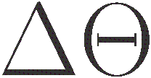
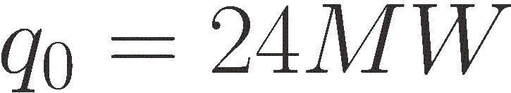
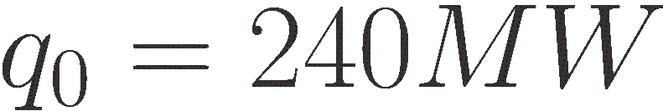

Slide 19
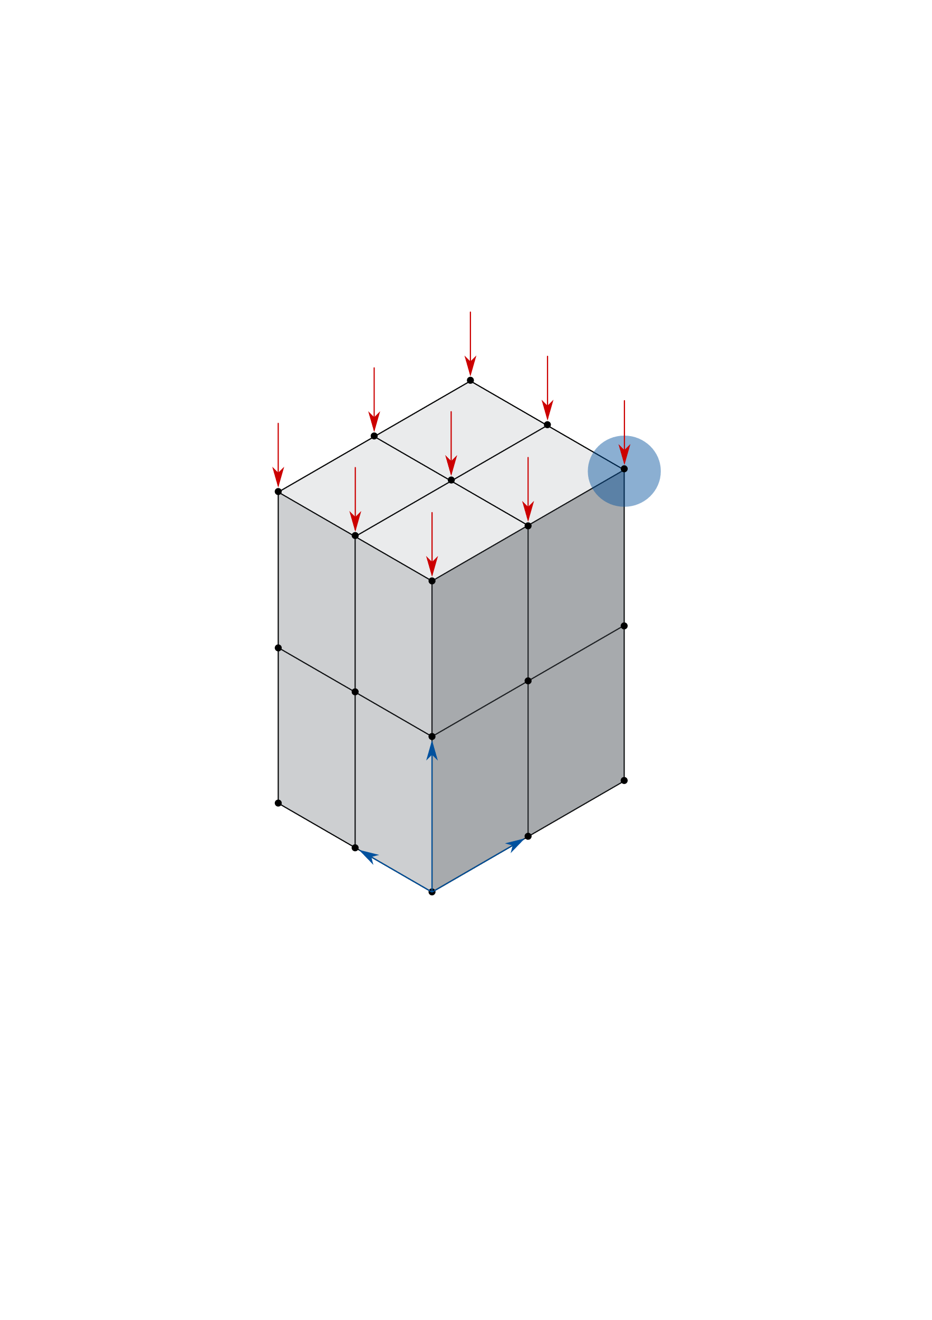





Slide 20
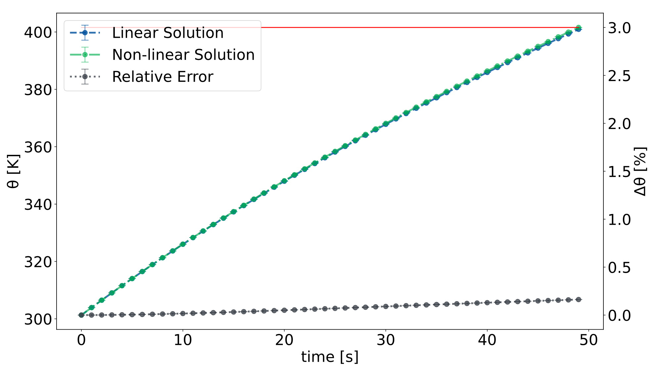
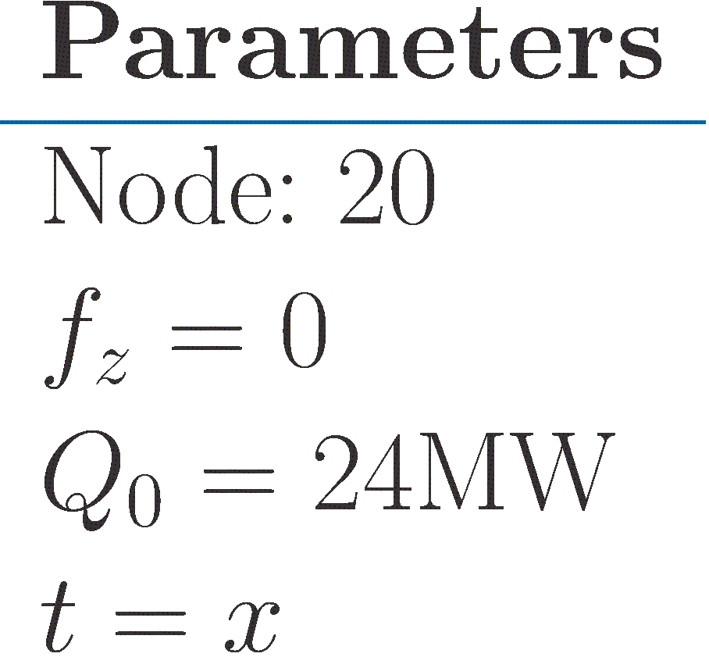

Slide 21
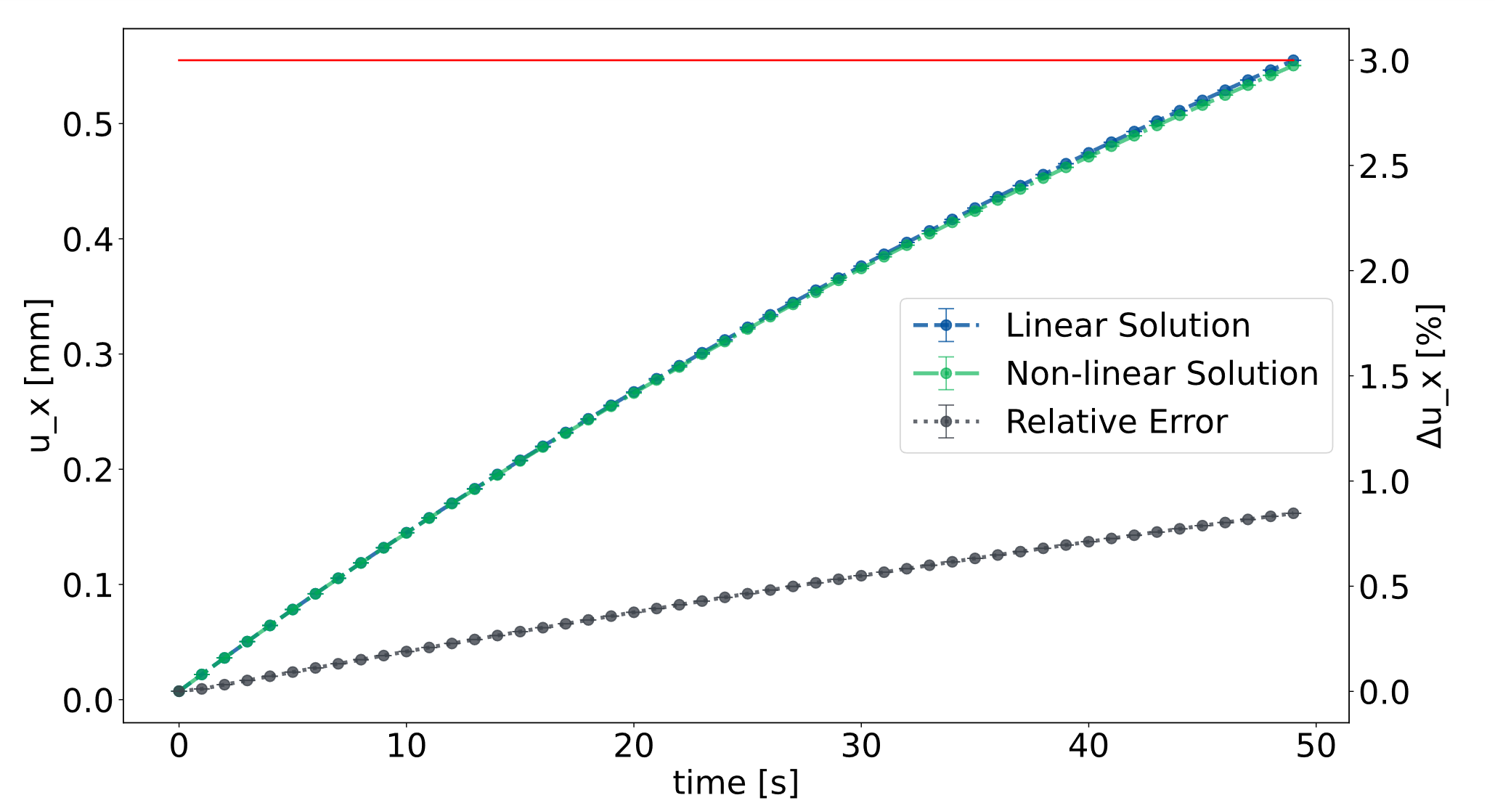

Slide 22
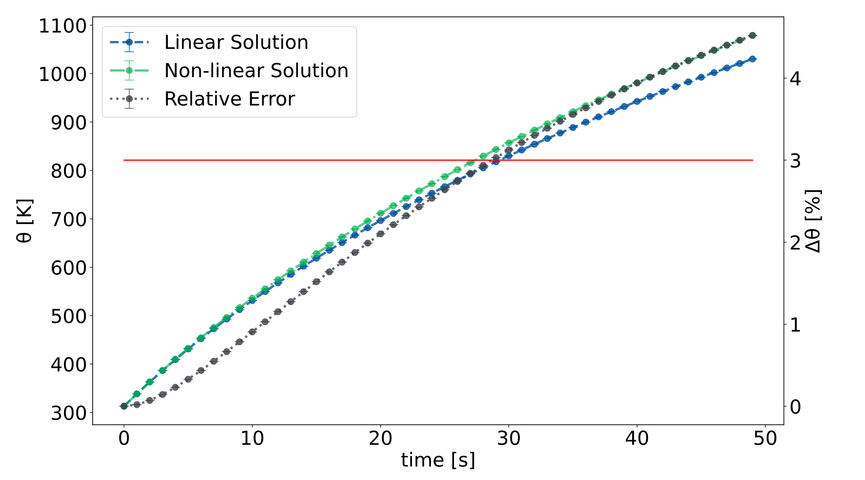
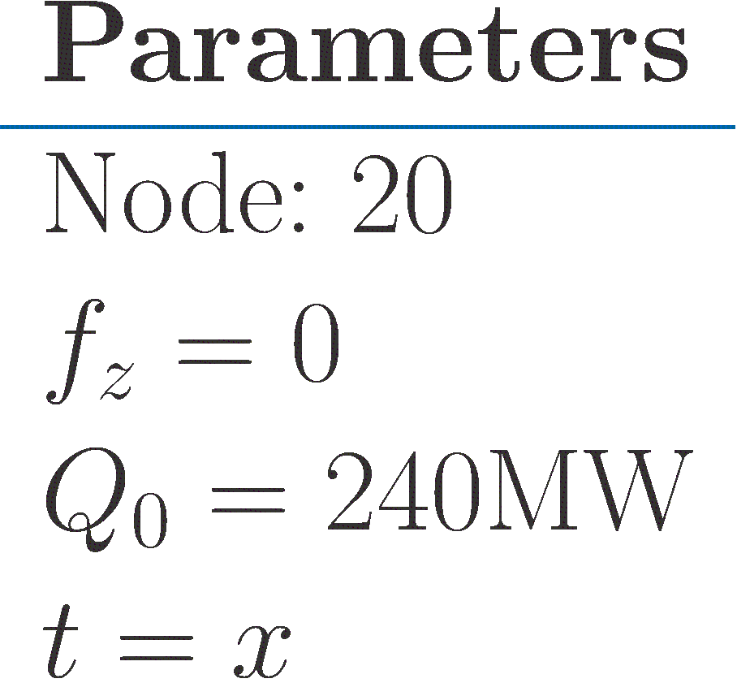

Slide 23
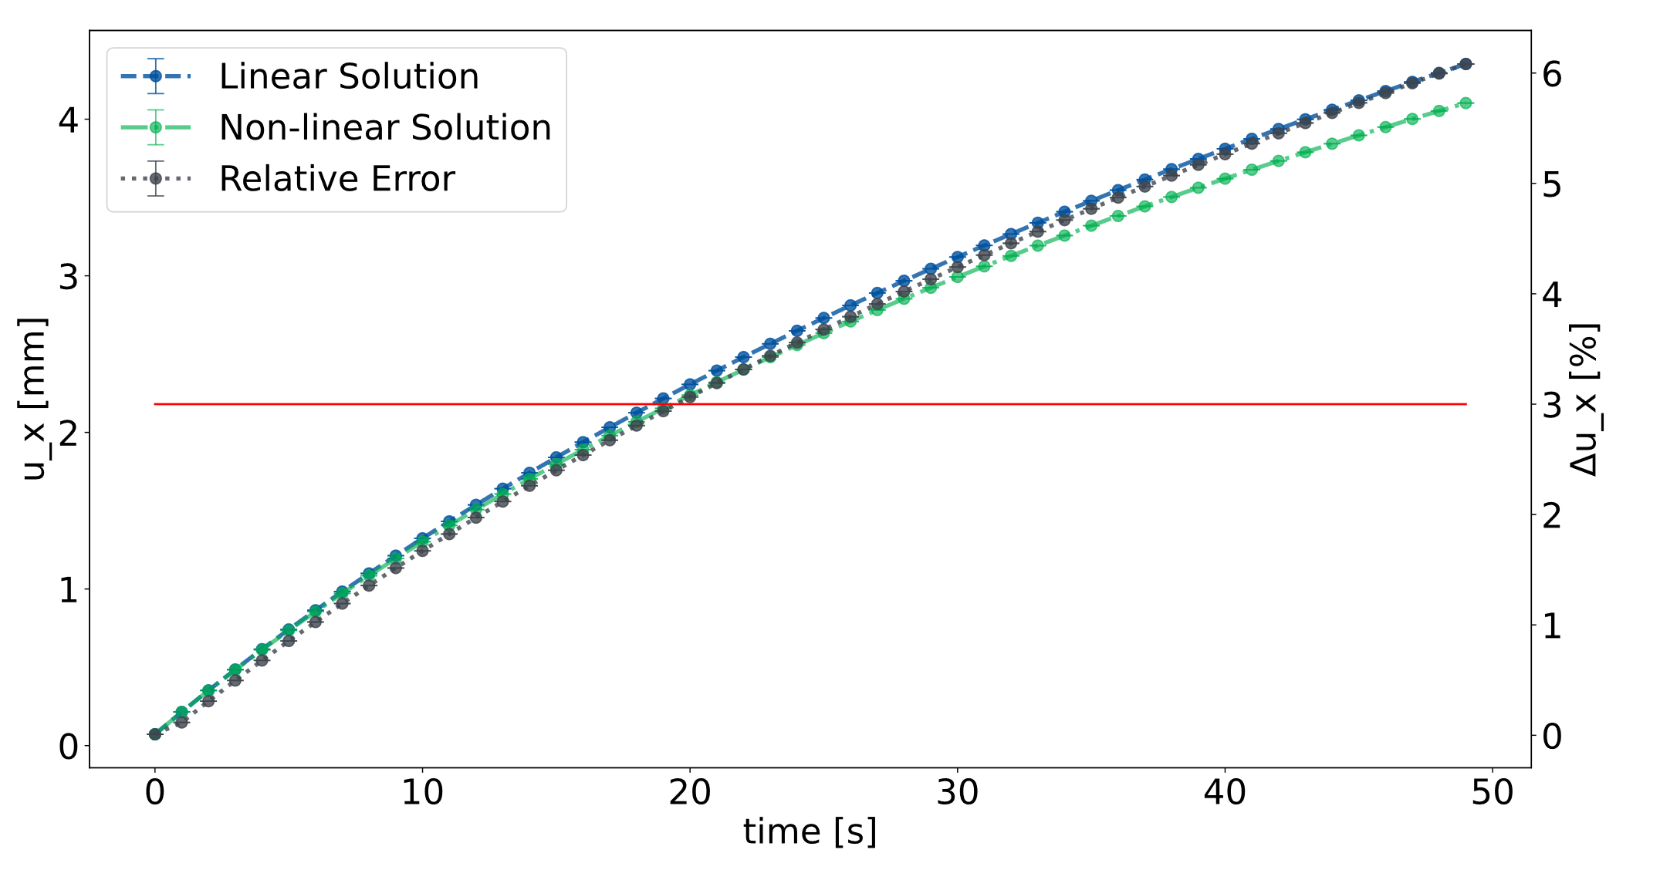

Slide 24
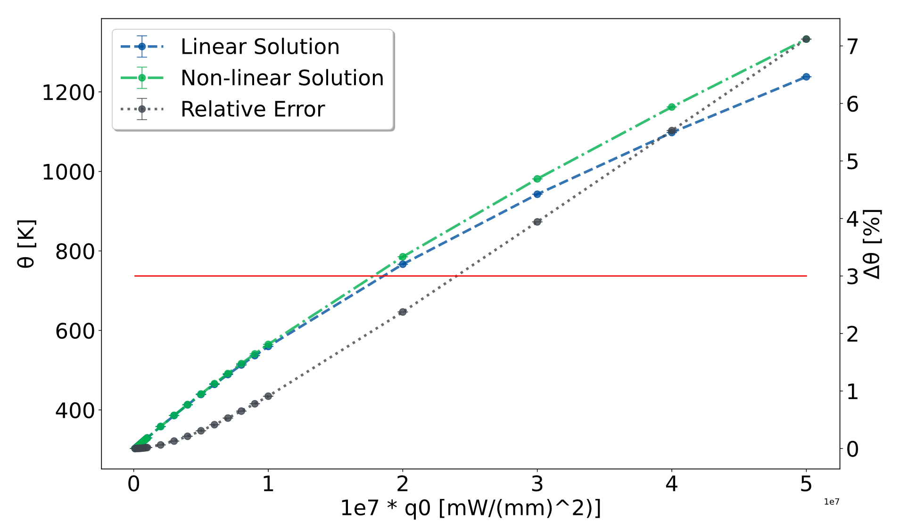
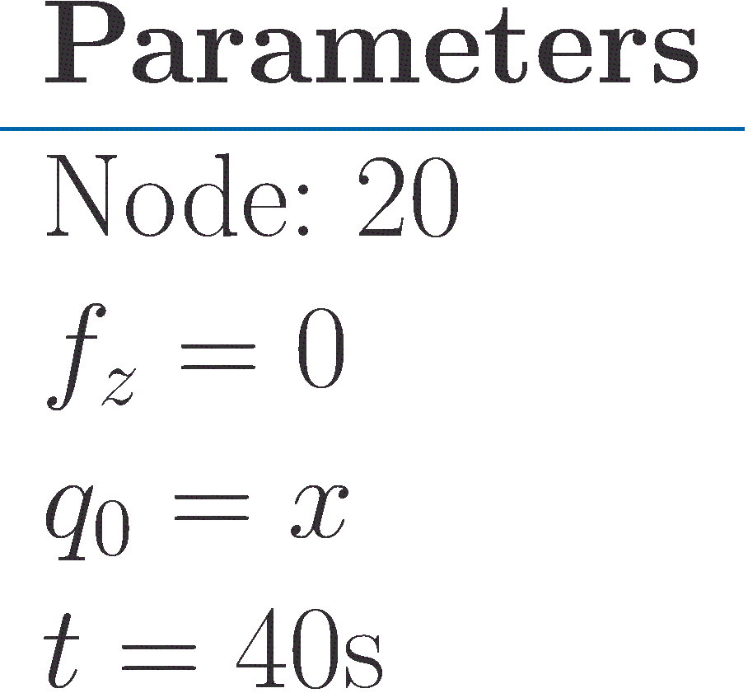

Slide 25

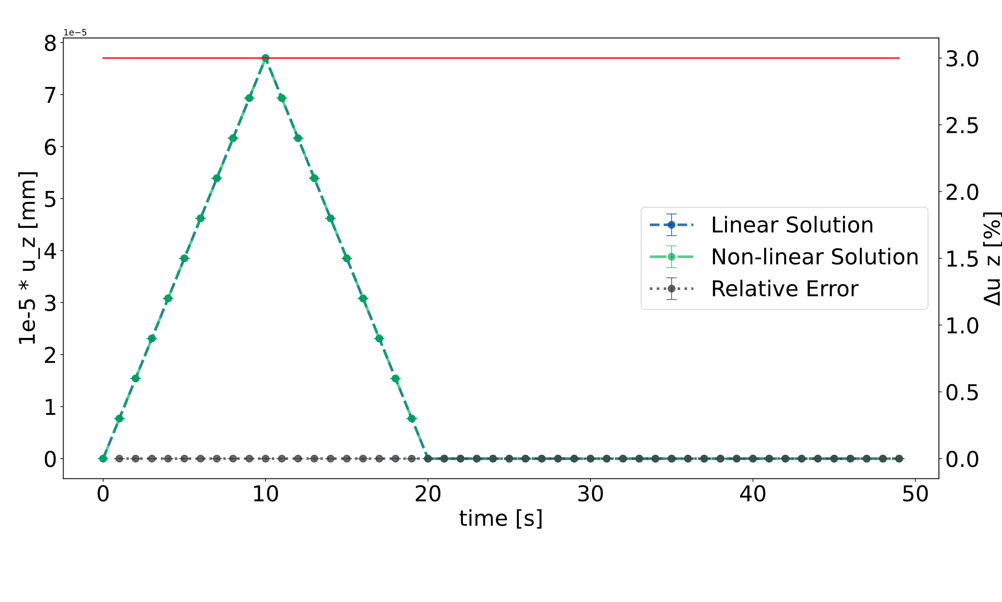
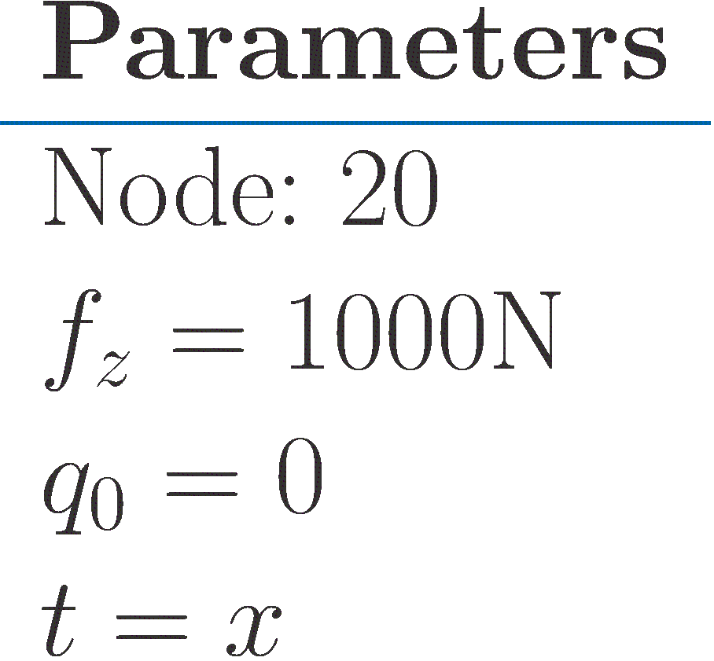

Slide 26



Slide 27




Slide 28



Slide 29



Slide 30


Slide 31



